Slide 1
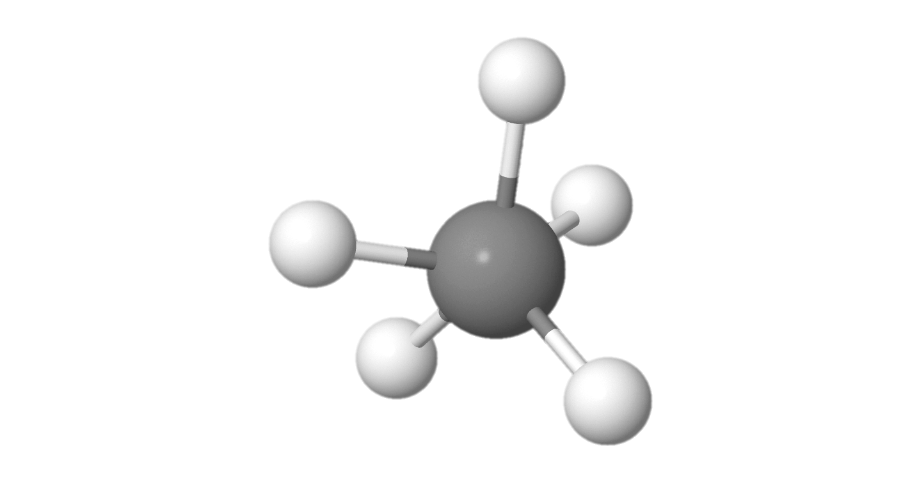
Diffusion monte carlo Rolling the dice but the dice are molecules
Meredith Fore
Physics PhD student @UW

Slide 2
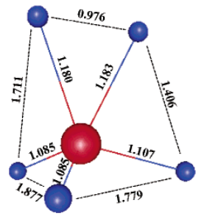

Carbon with FIVE hydrogen atoms?
It can exist!
An H₂ bound to a CH₃⁺
Minimum energy configuration
McCoy et al., J. Phys. Chem. A, 2004.
But that H₂ is not the same two hydrogen atoms all the time…
can we even say it has a structure?

Slide 3
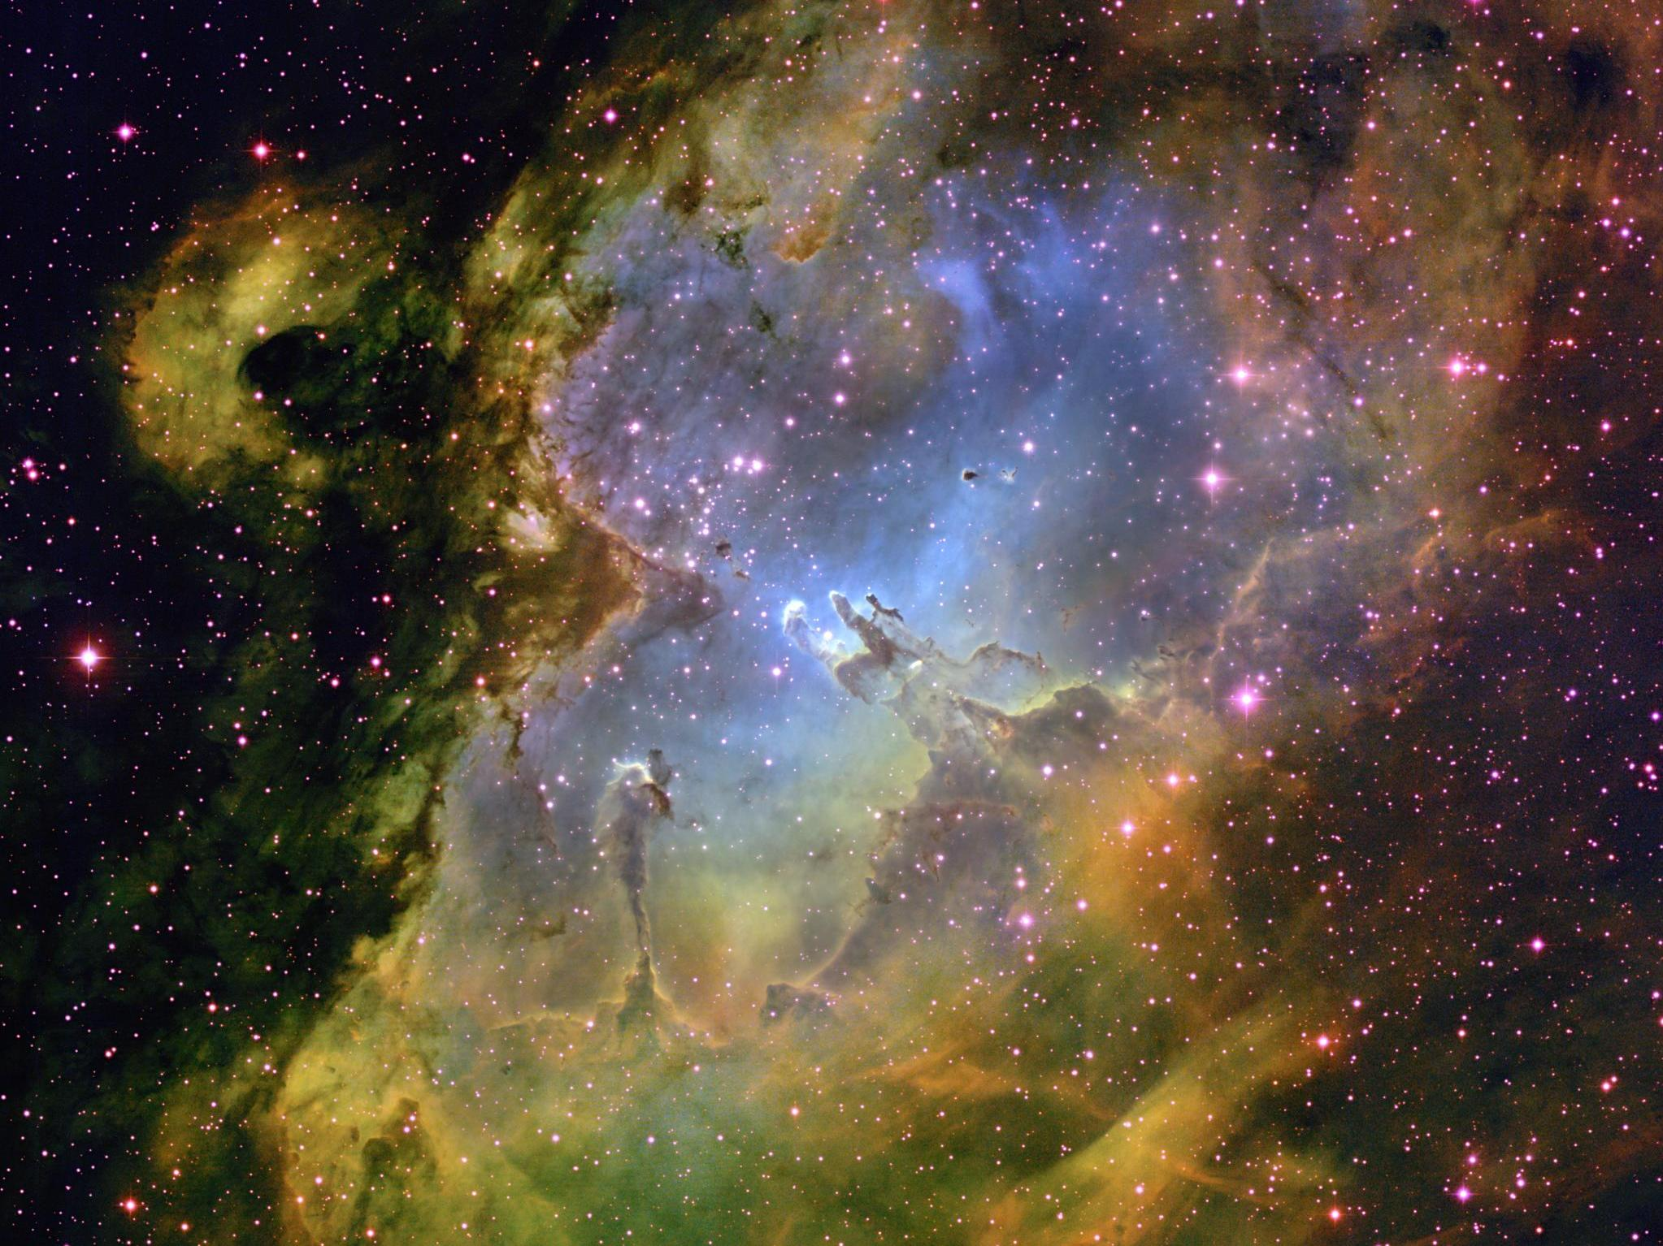
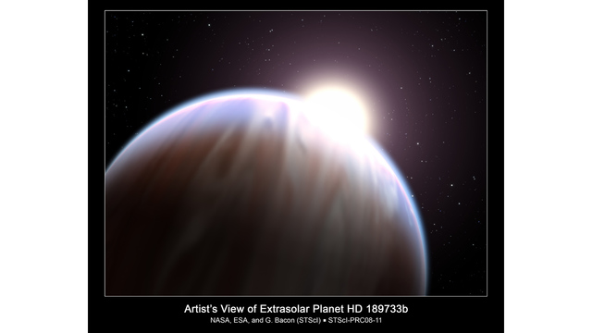
Astrochemistry: Chemicals in Space
Is the space between stars really empty?
What are stars/nebulae made of?
Do exoplanets have water/atmospheres?
Can we detect life on other planets?
Notes:
Rory Barnes, astrobiology prof at UW

Slide 4
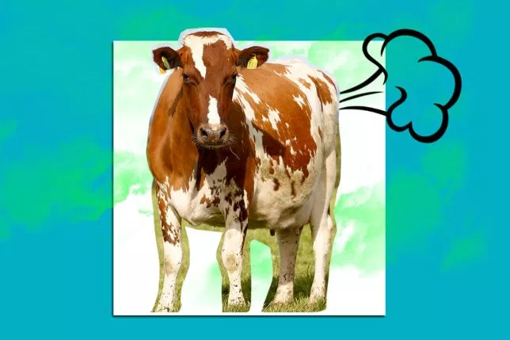
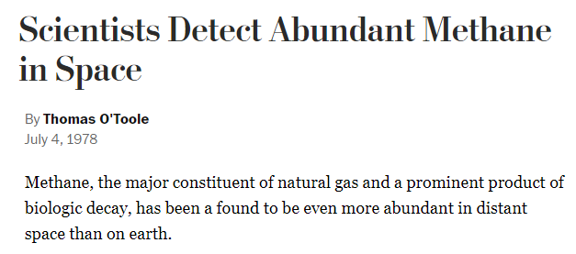
Astrochemistry: Chemicals in Space
-Washington Post, 1978
CH₄
One of the “building blocks” of life
How did it get there?
Methane
Notes:
Urrey experiment

Slide 5

Astrochemistry: Chemicals in Space
CH
CH₄
H₂CN⁺
CH₅⁺
Methane
CH₃⁺
N₂H⁺
CH₂⁺
CH₃OH₂⁺
CH⁺
CH₃CO⁺
CH₃OH
H₃⁺
H₂⁺
CH₂CO
H₂
HCO⁺
H

Slide 6
Astrochemistry: Chemicals in Space
CH
CH₄
H₂CN⁺
CH₅⁺
Methane
CH₃⁺
N₂H⁺
CH₂⁺
CH₃OH₂⁺
CH⁺
CH₃CO⁺
CH₃OH
H₃⁺
H₂⁺
CH₂CO
H₂
HCO⁺
H
Notes:
Completing this chain with observations is what’s going to tell us how we get chemicals that we recognize as biological, in a place where there is no biology

Slide 7
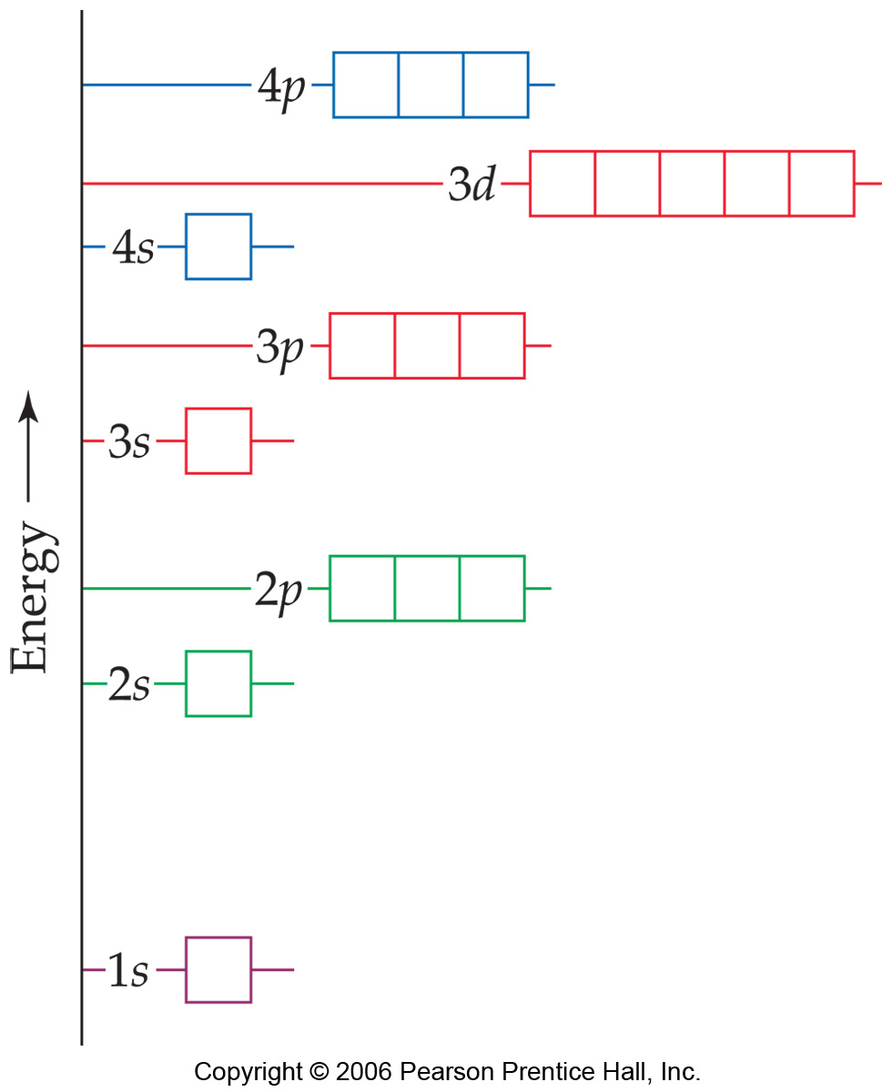
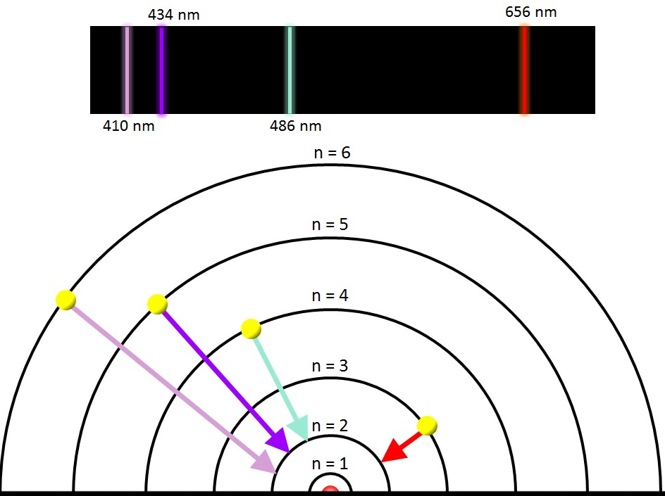
Electronic Energy
“quantized” = quantum mechanics!
Atoms/molecules are only allowed to have certain energies
So they can only absorb or emit light (photons) of certain energies
Electron(s) can absorb or emit the energy to change orbitals
This pattern of energies is a unique fingerprint
Notes:
Absorb/emit – up/down levels

Slide 8
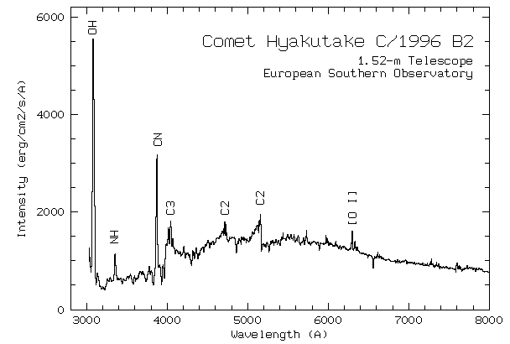
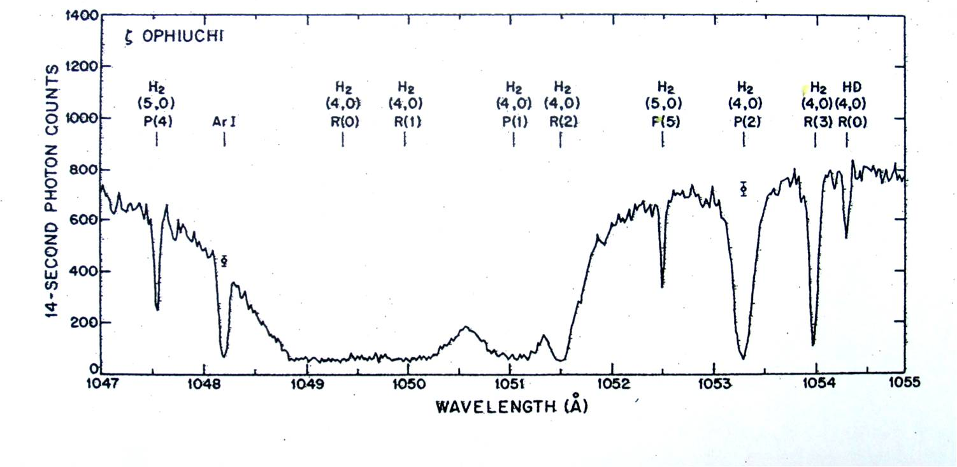
Recognize chemicals in space!

Slide 9
Electronic Energy
“quantized” = quantum mechanics!
Atoms/molecules are only allowed to have certain energies
So they can only absorb or emit light (photons) of certain energies
Electron(s) can absorb or emit the energy to change orbitals
This pattern of energies is a unique fingerprint

Slide 10
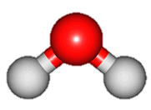
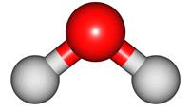

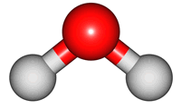

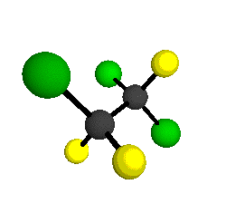
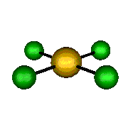
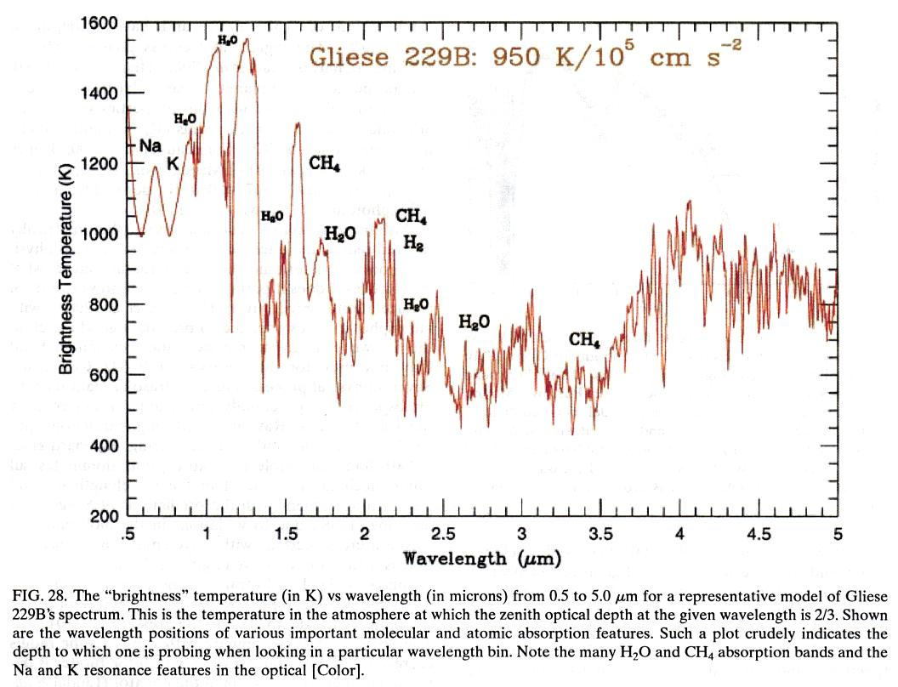
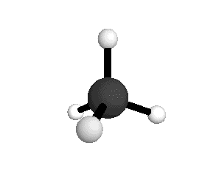
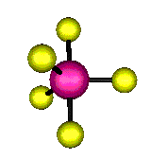
Vibrational Energy
also quantized!
This also gives us a unique fingerprint of energies

Slide 11
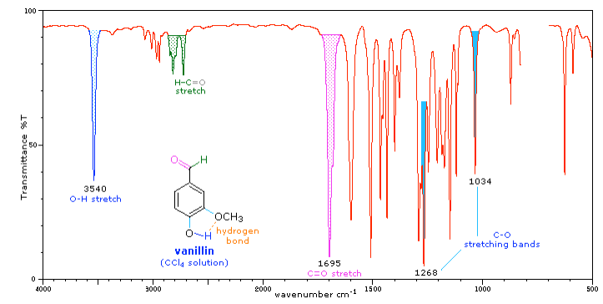
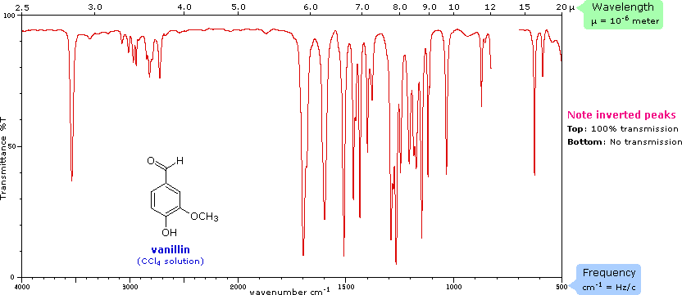
Vibrational Energy
Notes:
Left: OH stretch
Little CH stretches in methyl group
Right three: CO stretch

Slide 12
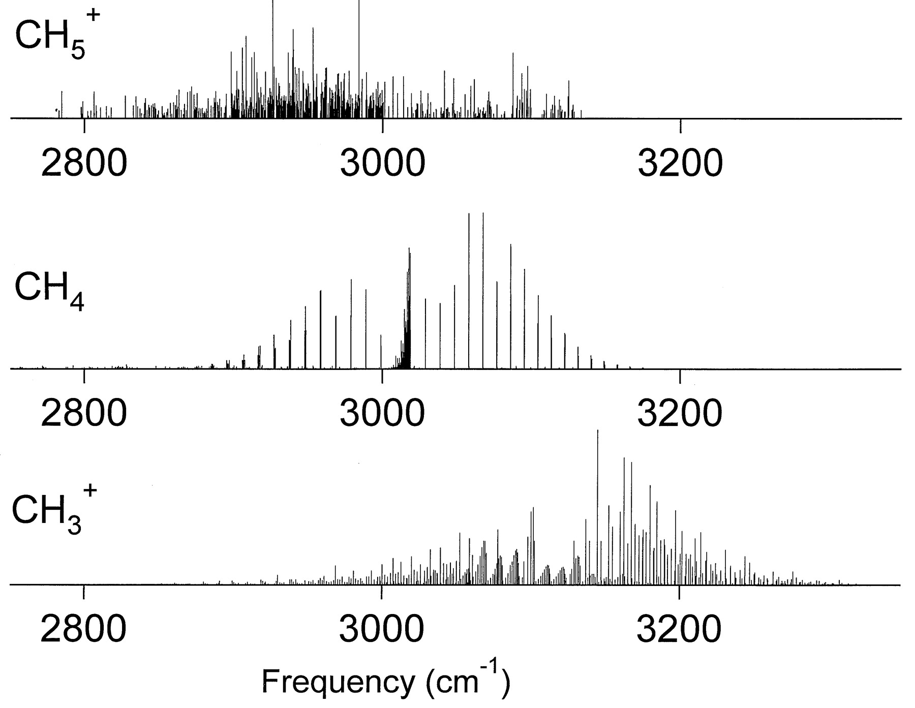
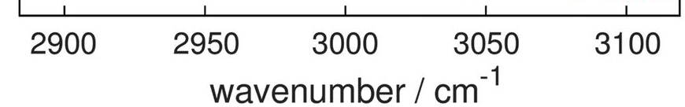
Asvany, Yamada, Brunken, Potapov, Schlemmer, Science (2015)
2897 lines
“enfant terrible”
It isn’t enough to have this spectrum; we must understand it
White, Tang and Oka, Science (1999)
Notes:
10K and 4K : cool things down so they have less energy, vibrate less, and have less in their spectrum. Not happening here!

Slide 13
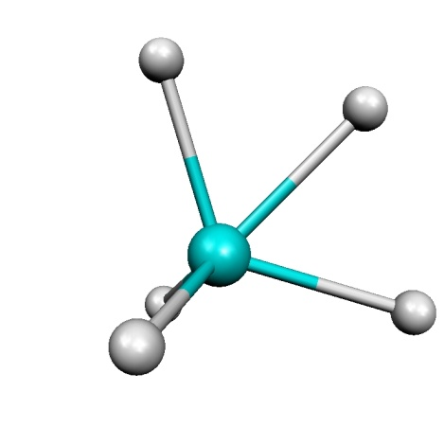
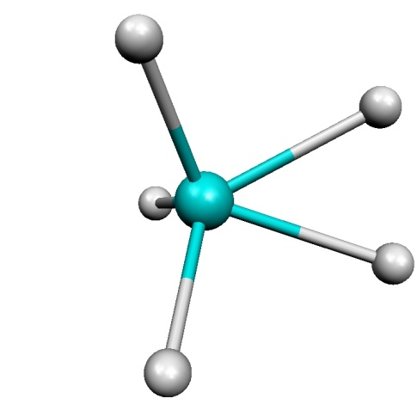
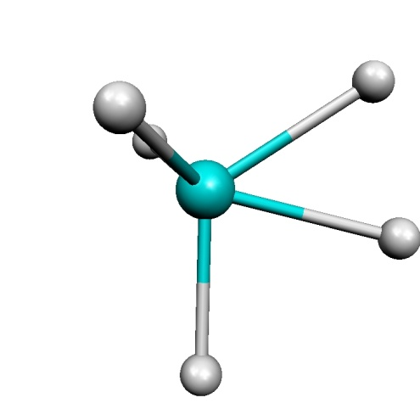
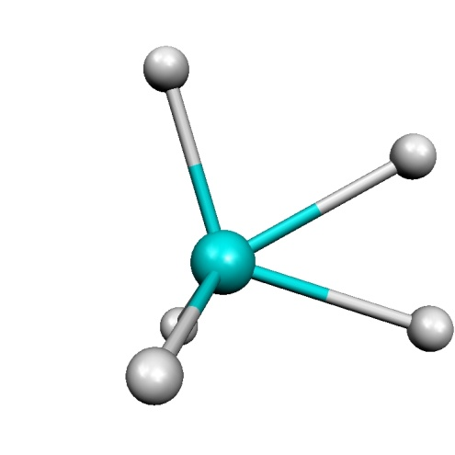
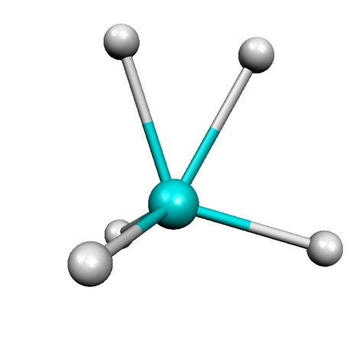
CH₅⁺ : Weird and wiggly
*Based on the surfaces of A. Brown, J. Zhong, B. J. Braams and J. M. Bowman
193 cm⁻¹ [MP2]
341 cm⁻¹ [CCSD(T)]
Molecule can access all 120 permutations of five hydrogen atoms in its ground state.
60º
rotation
No well-defined structure!
H-flip
What if we had a theoretical tool that didn’t need one?
43 cm⁻¹ [MP2]
29 cm⁻¹ [CCSD(T)]
0 cm⁻¹
Notes:
Has enough energy in its lowest energy state to do this
LIKE A RUBIX CUBE

Slide 14

Monte carlo
Monte Carlo refers to a class of computational algorithms that use random sampling to achieve numerical results
To implement Monte Carlo, you will need:
A range or domain from which to pull sample points (optional: a probability distribution within that domain)
A deterministic calculation to perform on your points
To collect all of your results

Slide 15
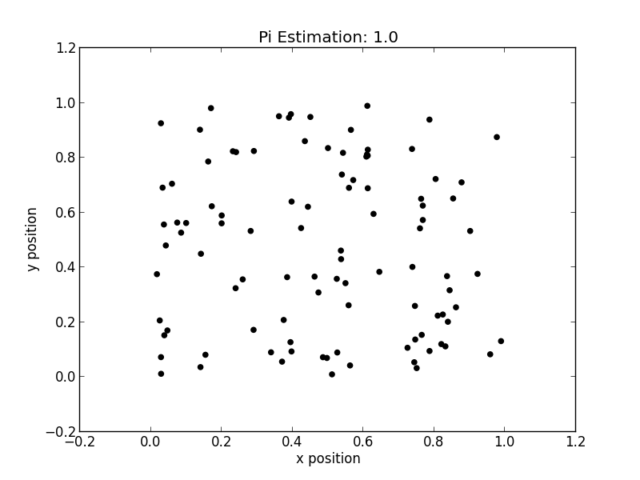
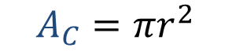
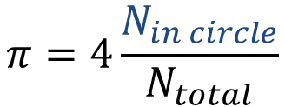
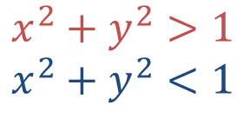
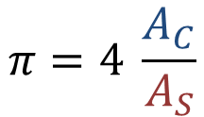
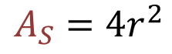
Monte carlo
$$A_{C}=πr^{2}$$
$$π=4 \frac{A_{C}}{A_{S}}$$
$$A_{S}=4r^{2}$$
What is my domain?
[0,1] in x and y.
What is my deterministic calculation?
Whether my point is in the area of the circle or not.
Mathematically:
$$x^{2}+y^{2}>1$$
$$x^{2}+y^{2}<1$$
Collect my results:
$$π=4\frac{N_{in circle}}{N_{total}}$$
Animation credit to Dr. Lindsey Madison

Slide 16
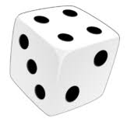
Diffusion Monte Carlo
x
Represent our wavefunction with points that we call “walkers”
Tag them: below or above average?
(Classically-allowed or classically-forbidden?)
Potential Energy
Roll the dice! Do they survive?
Do they get to replicate?
Avg Energy of all my points
x_{equil}
Notes:
Wavefunction represented as black points; Avg energy
Some of these points are in classically forbidden regions, potential greater than total energy
Classical, we’d delete them; quantum, they can tunnel, so they have a chance to survive
Classically allowed points we’ll give some chance to replicate

Slide 17
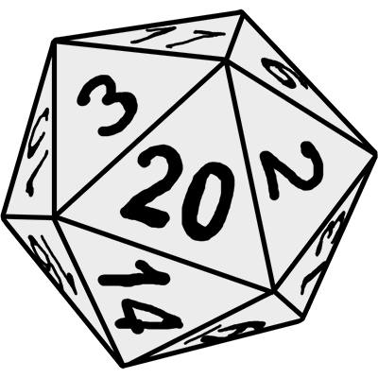
Diffusion Monte Carlo
x
Represent our wavefunction with points that we call “walkers”
Tag them: below or above average?
(Classically-allowed or classically-forbidden?)
Potential Energy
Roll the dice! Do they survive?
Do they get to replicate?
Diffuse your new set of points
Avg Energy of all my points
x_{equil}

Slide 18
Diffusion Monte Carlo
x
Represent our wavefunction with points that we call “walkers”
Tag them: below or above average?
(Classically-allowed or classically-forbidden?)
Potential Energy
Roll the dice! Do they survive?
Do they get to replicate?
Diffuse your new set of points
Take your new average energy, start over!
x_{equil}

Slide 19
Diffusion Monte Carlo
x
Represent our wavefunction with points that we call “walkers”
Tag them: below or above average?
(Classically-allowed or classically-forbidden?)
QUANTUM
Potential Energy
Roll the dice! Do they survive?
Do they get to replicate?
Diffuse your new set of points
Take your new average energy, start over!
x_{equil}

Slide 20
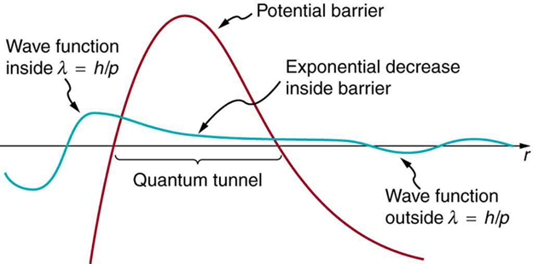
Quantum tunneling
Non-zero probability of being in a region where the potential energy is greater than the energy of the system
Quantum mechanics and Monte Carlo: both inherently probabilistic!

Slide 21
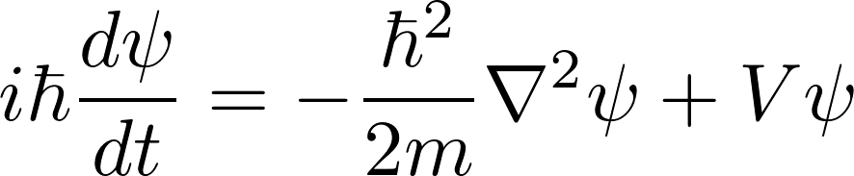

Quantum monte carlo
There are many different flavors of quantum Monte Carlo.
They all have essentially one goal: solve the Schrödinger equation.
Usual data run:
25,000 walkers
10,000 timesteps
x10 simulations
Time: ~10 hours
Get the wavefunction: $ψ$

Slide 22
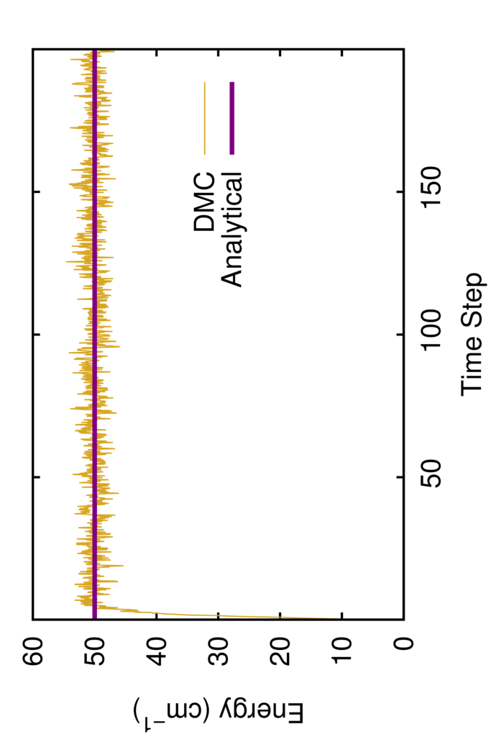
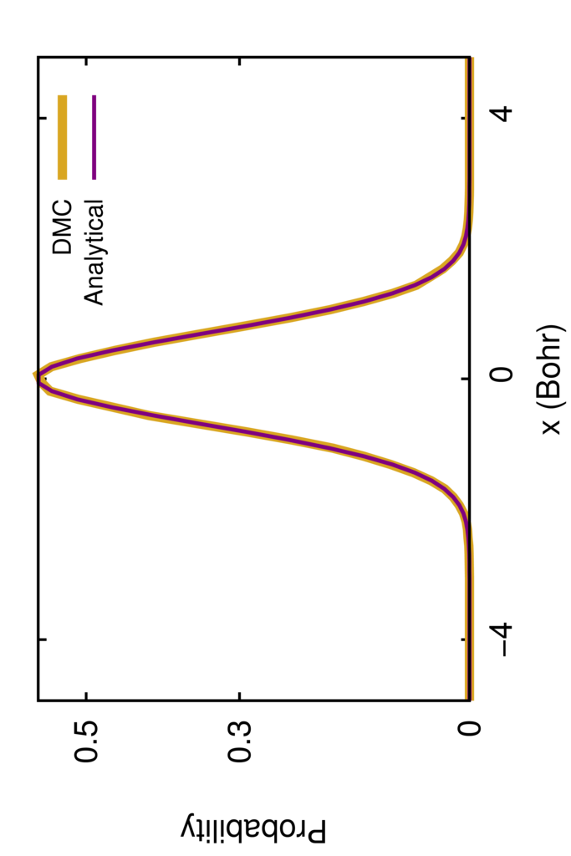
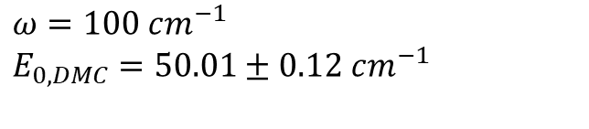
DMC can calculate:
Zero-point energy
Wavefunction as a density of walkers
$$ω=100 cm^{−1}$$
$$E_{0,DMC}=50.01±0.12 cm^{−1}$$
But how do I look at a multi-dimensional density?
Notes:
Density = wavefunction

Slide 23
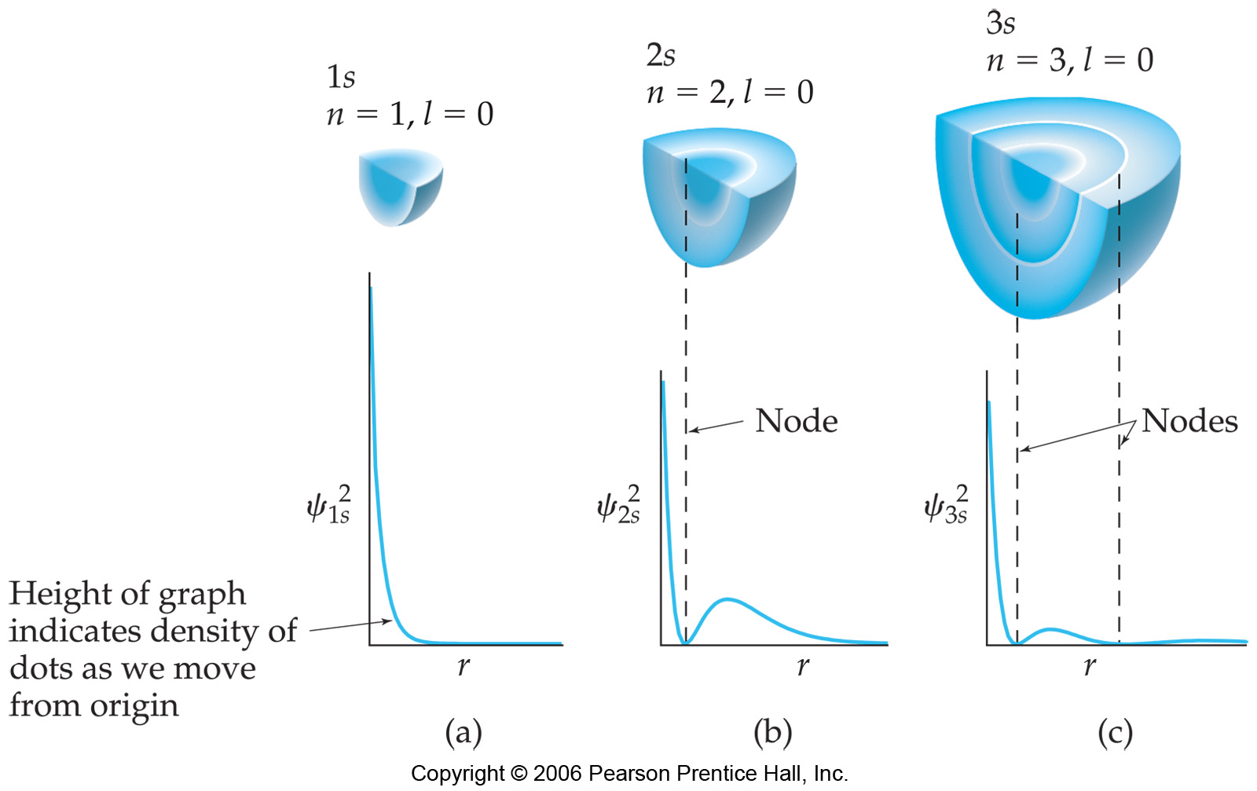
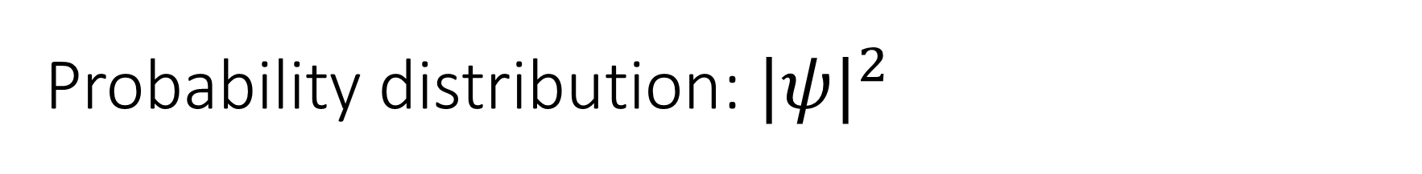
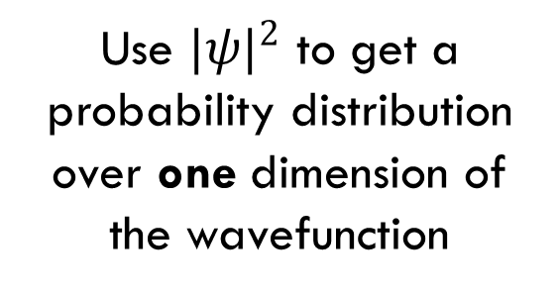
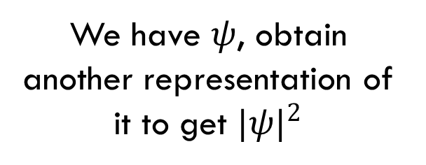
Probability distribution: ${|ψ|}^{2}$
We have $ψ$, obtain another representation of it to get ${|ψ|}^{2}$
Use ${|ψ|}^{2}$ to get a probability distribution over one dimension of the wavefunction

Slide 24
C-H, C-D Distributions
Probability Amplitude
C-H or C-D Distances (Angstroms)

Slide 25
Internuclear 1D Probability Distributions
CH₅⁺
CH₄D⁺
CH₃D₂⁺
CH₂D₃⁺
CHD₄⁺
CD₅⁺
Min Energy
H-H, H-D, or D-D Distances (Angstroms)

Slide 26
Internuclear 1D Probability Distributions
CH₄D⁺
Probability Amplitude
H-H or H-D Distances (Angstroms)

Slide 27
Internuclear 1D Projections: H-H and D-D
CH₅⁺
CH₄D⁺
CH₃D₂⁺
CH₂D₃⁺
CH₃D₂⁺
CH₂D₃⁺
CHD₄⁺
CD₅⁺
H-H Distance (Angstroms)
D-D Distance (Angstroms)

Slide 28
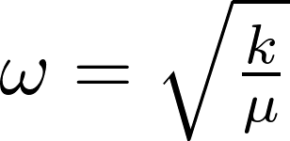

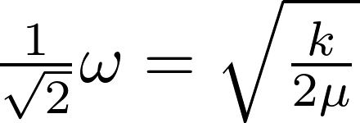
Not all five positions are equal!
The C-H bonds in the CH₃⁺ are stronger (higher energy, frequency) than the C-H bonds in the H₂
The molecule’s zero point energy is lowered more if we place a higher-mass atom in a position with a stronger C-H bond
Can we quantify how the distributions are changing as we add mass?

Slide 29
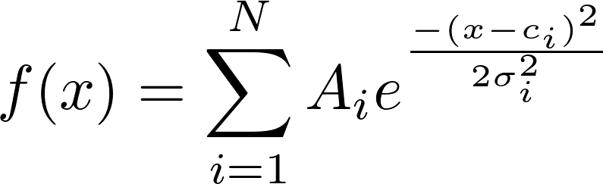
Can we get to underlying physics by fitting?
But how many Gaussians do I need?
Notes:
LOOKING FOR A PATTERN;

Slide 30
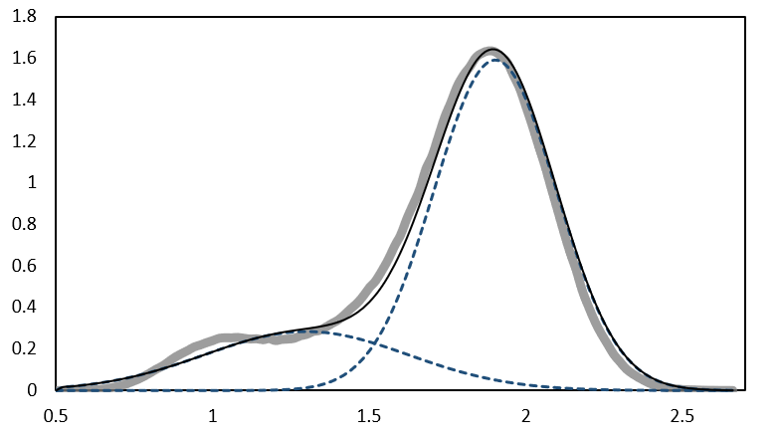
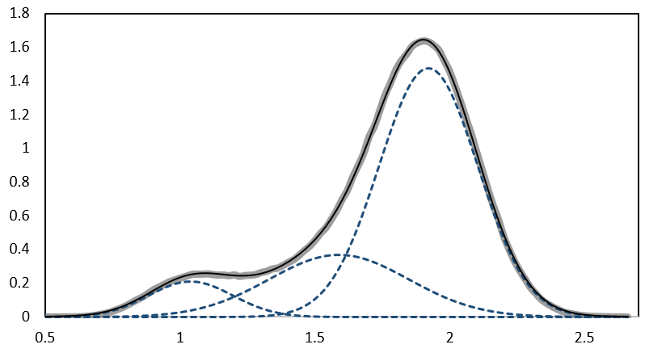
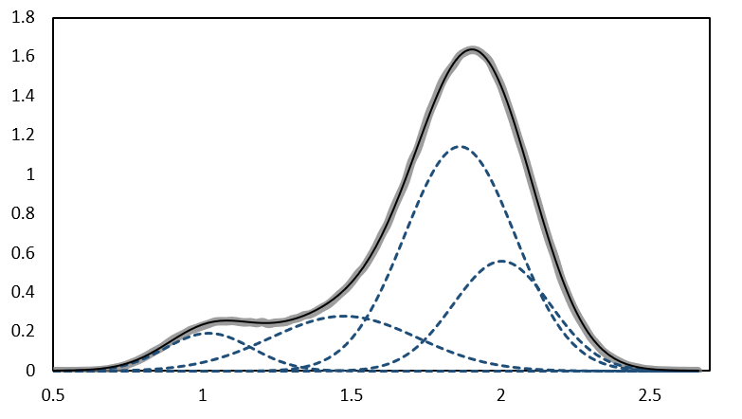


The fits keep getting better!
Log-likelihood: a measure of how “likely” it is for the model to sufficiently explain the data
The inverse of “how probable a set of data is, given a model”
Goodness-of-fit
Complexity

Slide 31
Log-likelihood
Maximum log-likelihood (arb. units)
N_{Gaussians}

Slide 32
Sum
H-H
Mean (Å)
Mean (Å)
CD₅⁺
CHD₄⁺
CH₅⁺
CH₃D₂⁺
CH₅⁺
CH₃D₂⁺
CH₂D₃⁺
CH₃D₂⁺
CH₂D₃⁺
CH₃D₂⁺
H-D
D-D
Mean (Å)
Mean (Å)
CHD₄⁺
CH₂D₃⁺
CH₃D₂⁺
CH₃D₂⁺
CD₅⁺
CHD₄⁺
CH₂D₃⁺
CH₃D₂⁺

Slide 33
Trends in Summed Distributions
CD₅⁺
CHD₄⁺
CH₄D⁺
CH₅⁺
CH₂D₃⁺
CH₃D₂⁺
Mixed isotopologues “flip” less
Min Energy
H-flip
60º
rotation
Reinforces localization we’ve seen

Slide 34


Current/Future Work
Implementing DMC with 5-dimensional angular momentum
Theorized by Schmiedt, Schlemmer, and Jensen
Preliminary Results
Key Future Goal: What do these states mean physically?
Exp. CDs (cm⁻¹) | DMC (cm⁻¹) | Corresponding 5D transitions
26.472 | 25.869 | [3,0]-[1,0]
30.270 | 30.689 | [3,1]-[1,0]
36.353 | 38.581 | [3,2]-[1,0]
Use this new perspective to shed light on the physics behind the spectrum

Slide 35



Thank you!
Prof. Anne McCoy
Prof. Lindsey Madison
Dr. Meng Huang
Victor Lee
Ryan DiRisio
Mark Boyer
Mathew Joyner

